Slide 1
Welcome from Waikato Golf Association
Terry Booth – Chief Executive Officer
Stephen Sandford – Golf Development Officer
Dana Laing – Office Administrator

Slide 2
Futures Waikato
Futures Waikato participating clubs for 2024:
Pirongia
Hamilton
Morrinsville
Ngaruawahia
Te Awamutu
Horsham Downs
Hukanui
Ngahinepouri
Huntly Golf Club
Growing junior golf by offering more playing opportunities.
Giving easy and affordable access to PGA professional coaching.
Encouraging golf to be played as a family game.
Encouraging our 19+ to convert over to a full playing membership at one of our 9 participating clubs.

Slide 3
Futures Waikato Membership
2021 vs. 2024
BOYS 224 385
Girls 30 44
Totals: 254 429

Slide 4
Futures Waikato Coaching
Futures Waikato offer 9 sessions of PGA lead coaching for each of the 4 school terms. Our coaching venues for Term 1 of 2024:
Hamilton Golf Club – 5 Sessions
Ngaruawahia Golf Club – 1 Session
Te Awamutu Golf Club – 1 Sessions
St. Peters School – 2 Sessions
30 Children attended coaching in term one of 2021. Now, we have availability for up to 92 Children to attend coaching in 2024.
Coaching sessions have been specifically tailored for children to get the most out of each session based on age and ability.
Term 2 coaching sessions are already filling up quickly. In order to accommodate the growing demand, we are once again looking to add more sessions.

Slide 5
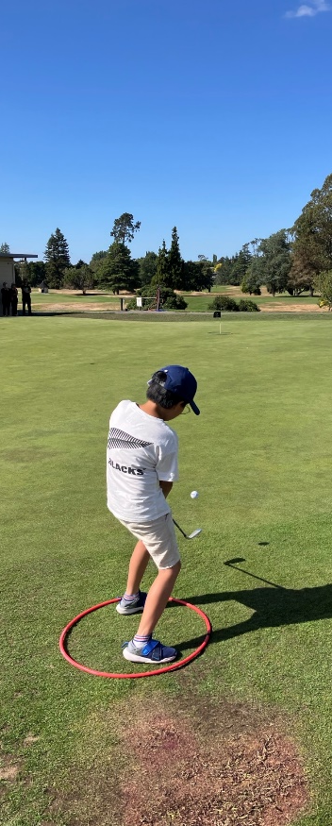
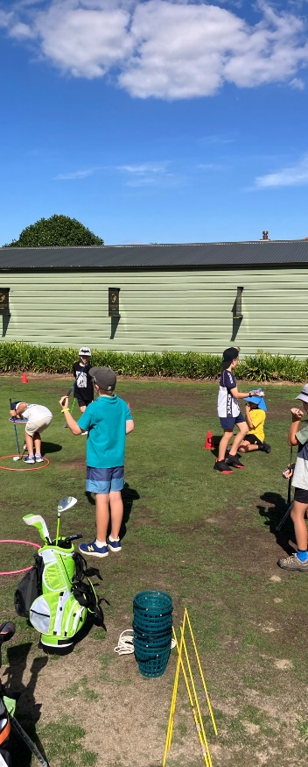
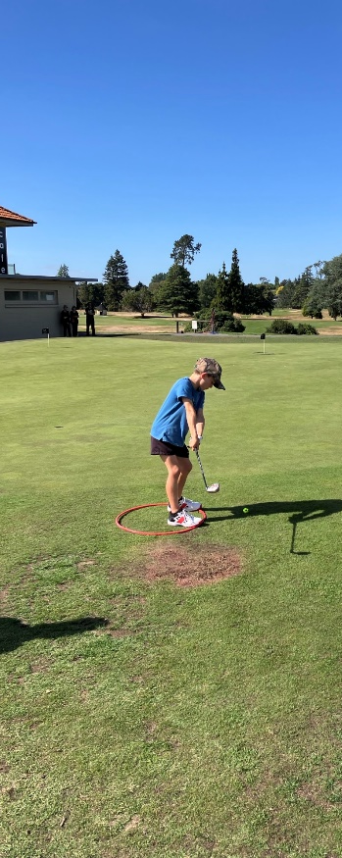
COACHING Term 1 – SNAG
@ HAMILTON

Slide 6
JUNIOR GOLF
More opportunities in 2024
In-School Sessions
Junior Pennants Series
Youth Town “Her Move Programme” – Snag Sessions
= GROWTH
Futures Waikato Events 2024
23rd June Futures Waikato Event – Morrinsville Golf Club
7th July Waikato Society vs BOP Society
21st July RD1 Junior Pennants – Hamilton Golf Club
28th July RD2 Junior Pennants – Matamata Golf Club
4th August Booth Shield trial 36 holes
11th August RD3 Junior Pennants / Futures Event – Huntly Golf Club
18th August Junior Pennants Grand Final- TBC / Neutral Course
15th September Booth Shield trial 36 Holes
22nd September Futures Waikato Event – Ngaruawahia Golf Club
13th October Futures Waikato Event - TBC
3rd November Futures Waikato Event - TBC
26th/28th October Booth Shield
24th November Futures Waikato Christmas Open – Te Awamutu Golf Club
22nd December Christmas Fundraising Ambrose / WJGS at Tahuna Golf Club

Slide 7
Inter-school Golf Events
Intercollegiate Champs Day
2024 To be held at Matamata Golf Club
Intercollegiate Teams Day
2024 To be held at Hamilton Golf Club
Primary & Intermediate Schools Competition
2024 To be held at Ngahinepouri Golf Club
Waikato Secondary Schools Matchplay Championships (2 Days)
2024 To be held at Te Awamutu Golf Club

Slide 8
Interclub - Women
WGA manage and facilitate interclub golf across the region, 90 Teams (324 Participants) compete across the following;
Waikato Women’s Interclub Pennants:
Women’s Championship Pennants
Women’s Weekday Pennants
Women’s Weekend Pennants
Women’s 9 Hole Weekday Pennants
Women’s 9 Hole Teams Pennants
Women’s Champion of Champions 18 Hole Section
Women’s Champion of Champions 9 Hole Section
Wills Cup/Jug Cup Competition Final

Slide 9
Annual Women’s Events Overseen by Waikato Golf
10- Hole Foursomes at Matamata
Monica Pellow – 9- Hole Memorial at Ngaruawahia
Association Day
Mailman Salver
Waikato District National Teams Day Championship Final

Slide 10
Interclub - Men
WGA manage and facilitate interclub golf across the region, over 109 Teams (680 Participants) compete across the following;
Waikato Men’s Interclub Competitions
Championship Pennants (Division 1- 4 /32 Teams) 192 Participants
Coordination of 20 Host Venues/ 36 Draws / February – April 14th FINALS
Men’s Handicap Stroke-Play Pennants (Zones 1 & 2 /19 Teams) 76 Participants
Coordination of 7 Host Venues/ 7 Draws/ February – April 7th FINALS
Men’s Handicap Match-Play Pennants (Pools A-D / 26 Teams) 156 Participants
Coordination of 32 Host Venues/ 32 Draws/ February - June 23rd FINALS
Prebble Cup/ Tolich Trophy (32 Teams/8 players per team) 256 Participants
Coordination of 13 Host Venues/14 Draws/ August – October 15th FINALS
Men’s Champion of Champions

Slide 11
Representative
WGA run and continue to grow the following events:
Waikato Age Group Championships
Run as a two-day event due to increasing numbers
Race to Tieke - Associate Host
Junior Boys Inter-Provincials
Waikato Masters

Slide 12
National
WGA fund and outfit teams to the following events.
Boys Triangular and Girls Quadrangular
Boys Interprovincial
Girls Interprovincial
Men’s Interprovincial
Women’s Interprovincial
Freyberg Men’s Masters
Women’s Masters

Slide 13
WGA Financial Sources Summary
Waikato Golf Association is a Registered Not for Profit Charity.
Membership Levies
Grant Applications
Grassroots Trust
Lion Foundation
Futures Waikato Junior Membership
Tournaments

Slide 14
STATS

Slide 15
Estimated
Rounds Played by Region

Slide 16
REGION | ESTIMATED ROUNDS PLAYED
 | Jan 1 – March 13 2023 | Jan 1 – March 13 2024 | CHANGE
Aorangi | 27,975 | 31,255 | 11.7%
Auckland | 134,347 | 163,333 | 21.6%
Bay of Plenty | 96,386 | 123,707 | 28.3%
Canterbury | 129,309 | 137,906 | 6.6%
Hawkes Bay | 31,383 | 42,110 | 34.2%
Manawatu/Wanganui | 46,262 | 53,032 | 14.6%
North Harbour | 117,054 | 150,025 | 28.2%
Northland | 52,937 | 78,261 | 47.8%
Otago | 87,948 | 93,092 | 5.8%
Poverty Bay/E. Coast | 8,687 | 11,633 | 33.9%
Southland | 19,393 | 19,975 | 3.0%
Taranaki | 33,863 | 40,524 | 19.7%
Tasman | 57,311 | 52,313 | -8.7%
Waikato | 100,939 | 133,739 | 32.5%
Wellington | 107,669 | 121,050 | 12.4%
TOTAL | 1,051,463 | 1,251,954 | 19.1%

Slide 17
Member Counts National

Slide 18
National Membership Counts (January 2022 – February 2024)
Month End | Total | Men | Women | Boys | Girls | On previous Month | On same Month Last year
Jan-22 | 128,347 | 94,659 | 24,583 | 7,644 | 1,461 | 1.66% | 10.11%
Feb-22 | 129,232 | 95,157 | 24,799 | 7,811 | 1,465 | 0.69% | 10.22%
Mar-22 | 129,381 | 95,211 | 24,826 | 7,866 | 1,478 | 0.12% | 10.04%
Apr-22 | 129,708 | 95,176 | 24,982 | 8,059 | 1,491 | 0.25% | 9.86%
May-22 | 130,037 | 35,362 | 25,014 | 8,166 | 1,495 | 0.25% | 9.73%
Jun-22 | 130,291 | 95,482 | 25,067 | 8,230 | 1,512 | 0.20% | 10.36%
Jul-22 | 129,965 | 95,270 | 25,037 | 8,177 | 1,481 | -0.25% | 9.57%
Aug-22 | 130,680 | 95,911 | 25,143 | 8,155 | 1,471 | 0.55% | 9.90%
Sep-22 | 131,860 | 96,844 | 25,275 | 8,286 | 1,455 | 0.90% | 9.77%
Oct-22 | 133,581 | 97,881 | 25,516 | 8,689 | 1,495 | 1.31% | 9.40%
Nov-22 | 134,629 | 98,711 | 25,721 | 8,698 | 1,499 | 0.78% | 7.58%
Dec-22 | 135,794 | 99,627 | 25,822 | 8,837 | 1,508 | 0.87% | 7.56%
Jan-23 | 136,597 | 100,233 | 25,927 | 8,922 | 1,515 | 0.59% | 6.43%
Feb-23 | 136,731 | 100,132 | 25,940 | 9,138 | 1,521 | 0.10% | 5.80%
Mar-23 | 135,231 | 98,965 | 25,646 | 9,098 | 1,522 | -1.10% | 4.52%
Apr-23 | 134,323 | 98,322 | 25,439 | 9,052 | 1,510 | -0.67% | 3.56%
May-23 | 133,437 | 97,702 | 25,315 | 8,935 | 1,485 | -0.66% | 2.61%
Jun-23 | 133,429 | 97,725 | 25,317 | 8,911 | 1,476 | -0.01% | 2.41%
Jul-23 | 133,904 | 98,035 | 25,369 | 9,005 | 1,495 | 0.36% | 3.03%
Aug-23 | 134,475 | 98,536 | 25,404 | 9,040 | 1,495 | 0.43% | 2.90%
Sep-23 | 135,046 | 99,037 | 25,439 | 9,075 | 1,495 | 0.42% | 2.42%
Oct-23 | 136,905 | 100,216 | 25,644 | 9,525 | 1,520 | 1.38% | 2.49%
Nov-23 | 138,857 | 101,642 | 25,943 | 9,740 | 1,532 | 1.43% | 3.14%
Dec-23 | 139,163 | 101,784 | 26,014 | 9,823 | 1,542 | 0.22% | 2.48%
Jan-24 | 142,325 | 103,905 | 26,527 | 10,313 | 1,580 | 2.27% | 4.19%

Slide 19
Member Counts by Region

Slide 20
Regions - Membership Counts as of February 2024
MEMBER COUNTS | MEN | WOMEN | ADULTS | JUNIORS | TOTAL
AORANGI | 3,270 | 991 | 3,929 | 332 | 4,261
AUCKLAND | 18,235 | 4,009 | 20,918 | 1,326 | 22,244
BAY OF PLENTY | 8,810 | 2,753 | 10,089 | 1,474 | 11,563
CANTERBURY | 11,365 | 2,620 | 12,796 | 1,189 | 13,985
HAWKES BAY | 3,914 | 991 | 4,467 | 438 | 4,905
MANAWATU/WANGANUI | 5,333 | 1,165 | 5,813 | 685 | 6,498
NORTH HARBOUR | 9,713 | 2,622 | 11,466 | 869 | 12,335
NORTHLAND | 5,905 | 1,670 | 6,959 | 616 | 7,575
OTAGO | 9,487 | 2,818 | 11,329 | 976 | 12,305
POVERTY BAY/E. COAST | 1,132 | 273 | 1,252 | 153 | 1,405
SOUTHLAND | 2,566 | 654 | 2,934 | 286 | 3,220
TARANAKI | 3,968 | 919 | 4,161 | 726 | 4,887
TASMAN | 4,054 | 1,142 | 4,804 | 392 | 5,196
WAIKATO | 10,141 | 2,640 | 12,781 | 1,599 | 14,380
WELLINGTON | 15,695 | 2,830 | 17,413 | 1,112 | 18,525
 | 114,719 | 28,234 | 130,794 | 12,159 | 142,953

Slide 21
Member Counts Waikato District

Slide 22
Waikato Region Membership Figures
(as of 21/02/2024)
2023 2024
Women/Junior Girls: 2,067 2,777
Men/Junior Boys: 10,773 11,603
Total Members: 12,840 14,380 (+12%)

Slide 23
Membership Counts
By Club
Waikato District

Slide 24
CLUB ID | MALE | FEMALE | JR BOY | JR GIRL | TOTAL HC | SECONDARY | TOTAL MEMBERS
CAMBRIDGE | 410 | 123 | 71 | 2 | 606 | 27 | 633
COROMANDEL | 100 | 32 | 2 | 0 | 134 | 34 | 168
FUTURES WAIKATO | 0 | 0 | 385 | 44 | 429 | 0 | 429
HAMILTON | 602 | 156 | 1 | 1 | 760 | 226 | 986
HAURAKI | 299 | 59 | 25 | 0 | 383 | 17 | 400
HORSHAM DOWNS | 382 | 69 | 6 | 4 | 461 | 73 | 534
HUKANUI | 297 | 64 | 18 | 0 | 379 | 30 | 409
HUNTLY | 157 | 18 | 4 | 2 | 181 | 31 | 212
KAWHIA | 38 | 14 | 3 | 0 | 55 | 5 | 60
LAKES RESORT | 54 | 18 | 4 | 1 | 77 | 48 | 125
MANGAKINO | 51 | 14 | 6 | 1 | 72 | 16 | 88
MATAMATA | 193 | 49 | 28 | 1 | 271 | 20 | 291
MERCURY BAY | 297 | 116 | 17 | 1 | 431 | 42 | 473
MORRINSVILLE | 305 | 57 | 19 | 2 | 383 | 50 | 433
NGAHINEPOURI | 249 | 73 | 20 | 0 | 342 | 38 | 380
NGARUAWAHIA | 589 | 129 | 4 | 0 | 722 | 104 | 826
OKOROIRE | 34 | 5 | 0 | 0 | 39 | 2 | 41
PAEROA | 168 | 39 | 14 | 3 | 224 | 4 | 228
PAUANUI | 126 | 60 | 45 | 5 | 236 | 68 | 304
PIOPIO ARIA | 82 | 21 | 10 | 1 | 114 | 10 | 124
PIRONGIA | 184 | 29 | 28 | 0 | 241 | 13 | 254
PURANGI | 102 | 21 | 10 | 3 | 136 | 42 | 178
PUTARURU | 125 | 20 | 9 | 0 | 154 | 3 | 157
RAGLAN | 191 | 44 | 6 | 1 | 242 | 25 | 267
ST. ALEXANDER | 142 | 30 | 11 | 0 | 183 | 17 | 200
TAHUNA | 108 | 33 | 1 | 0 | 142 | 4 | 146
TAIRUA | 160 | 56 | 18 | 1 | 235 | 43 | 278
TAUMARUNUI | 168 | 88 | 23 | 2 | 281 | 20 | 301
TE AKAU | 21 | 5 | 0 | 0 | 26 | 2 | 28
TE AROHA | 133 | 30 | 4 | 0 | 167 | 10 | 177
TE AWAMUTU | 325 | 78 | 23 | 6 | 432 | 42 | 474
TE KOWHAI | 71 | 11 | 3 | 1 | 86 | 2 | 88
THAMES | 128 | 49 | 8 | 2 | 187 | 11 | 198
THE DUNES | 194 | 67 | 20 | 0 | 281 | 134 | 415
TIEKE | 586 | 138 | 32 | 7 | 763 | 115 | 878
TIRAU | 145 | 37 | 4 | 0 | 186 | 9 | 195
TOKOROA | 291 | 32 | 20 | 1 | 344 | 5 | 349
WAIHI | 323 | 135 | 29 | 1 | 488 | 56 | 544
WAIKARE | 164 | 56 | 2 | 0 | 222 | 23 | 245
WAITERIMU | 79 | 13 | 2 | 0 | 94 | 8 | 102
WAITOMO | 116 | 35 | 19 | 3 | 173 | 6 | 179
WALTON | 272 | 91 | 24 | 2 | 389 | 20 | 409
WHANGAMATA | 443 | 180 | 62 | 3 | 688 | 149 | 837

Slide 25
Course Rating Schedule

Slide 26
2023 Completed 2024 Scheduled
Stewart Alexander
Walton
Waiterimu
Hamilton
Ngahinepouri
Hukanui
Morrinsville
Pio Pio Aria
Waihi
Matamata
Raglan
Okoroire
Coromandel
The Dunes
Mercury Bay
Tairua
Lakes Resort
Purangi
Kawhia
Pirongia
Tokoroa
Cambridge
Te Kowhai
“Well done to the Team, Waikato Course rating personnel, the numbers achieved in 2023 were outstanding. We look forward to working with you in 2024, to record similar statistics.”
Phil Aickin, Golf NZ
Handicapping & Golf Services Manager

Slide 27
Summary
It is indisputable that physical activity (i.e. golf) has positive physical and mental health benefits for those participants in the wider community. It is therefore crucial for Waikato Golf to continue delivering our community programs going forward.

Slide 28
THANK YOU FROM THE TEAM AT WAIKATO GOLF Terry, Dana & Stephen

